Slide 1
Seurat Objects: Under the hood
To prepare for today’s workshop, please:
Ensure that you have an updated copy of today’s markdown file
Can pull from GitHub (kidcancerlab/NCH_Coder_Upgrade)
We’ll be working from the folder Sessions/adv_Monday
RUN THE CHUNK starting with line 22 now!
This will download and unpack a dataset that we will use to illustrate some of the newer features in Seurat V5 in the latter half of the workshop
NOTE: The code for this session will run on a cluster or locally, either is fine. (So long as you run the code above and have BPCells installed [https://github.com/bnprks/BPCells]. This is already installed on Franklin and IGM..)

Slide 2
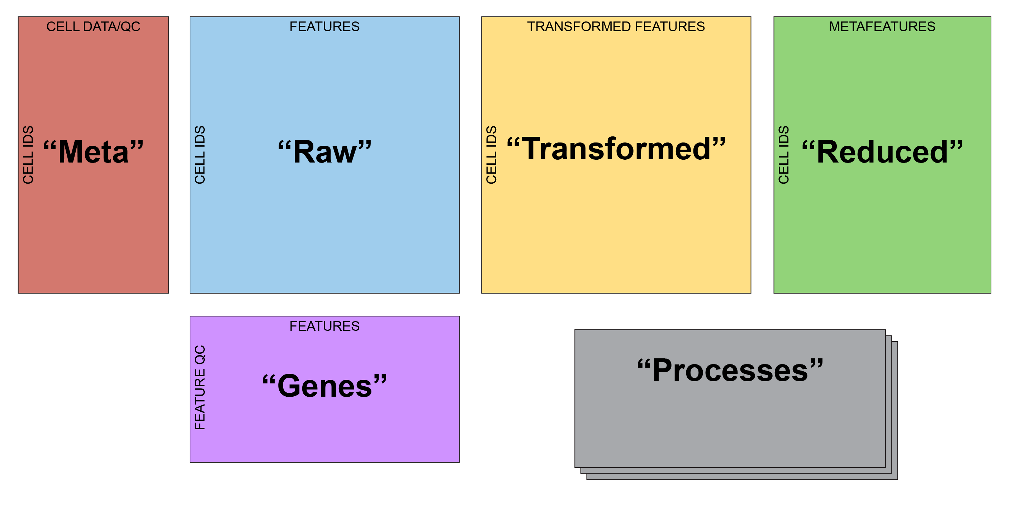
Single Cell Anatomy

Slide 3
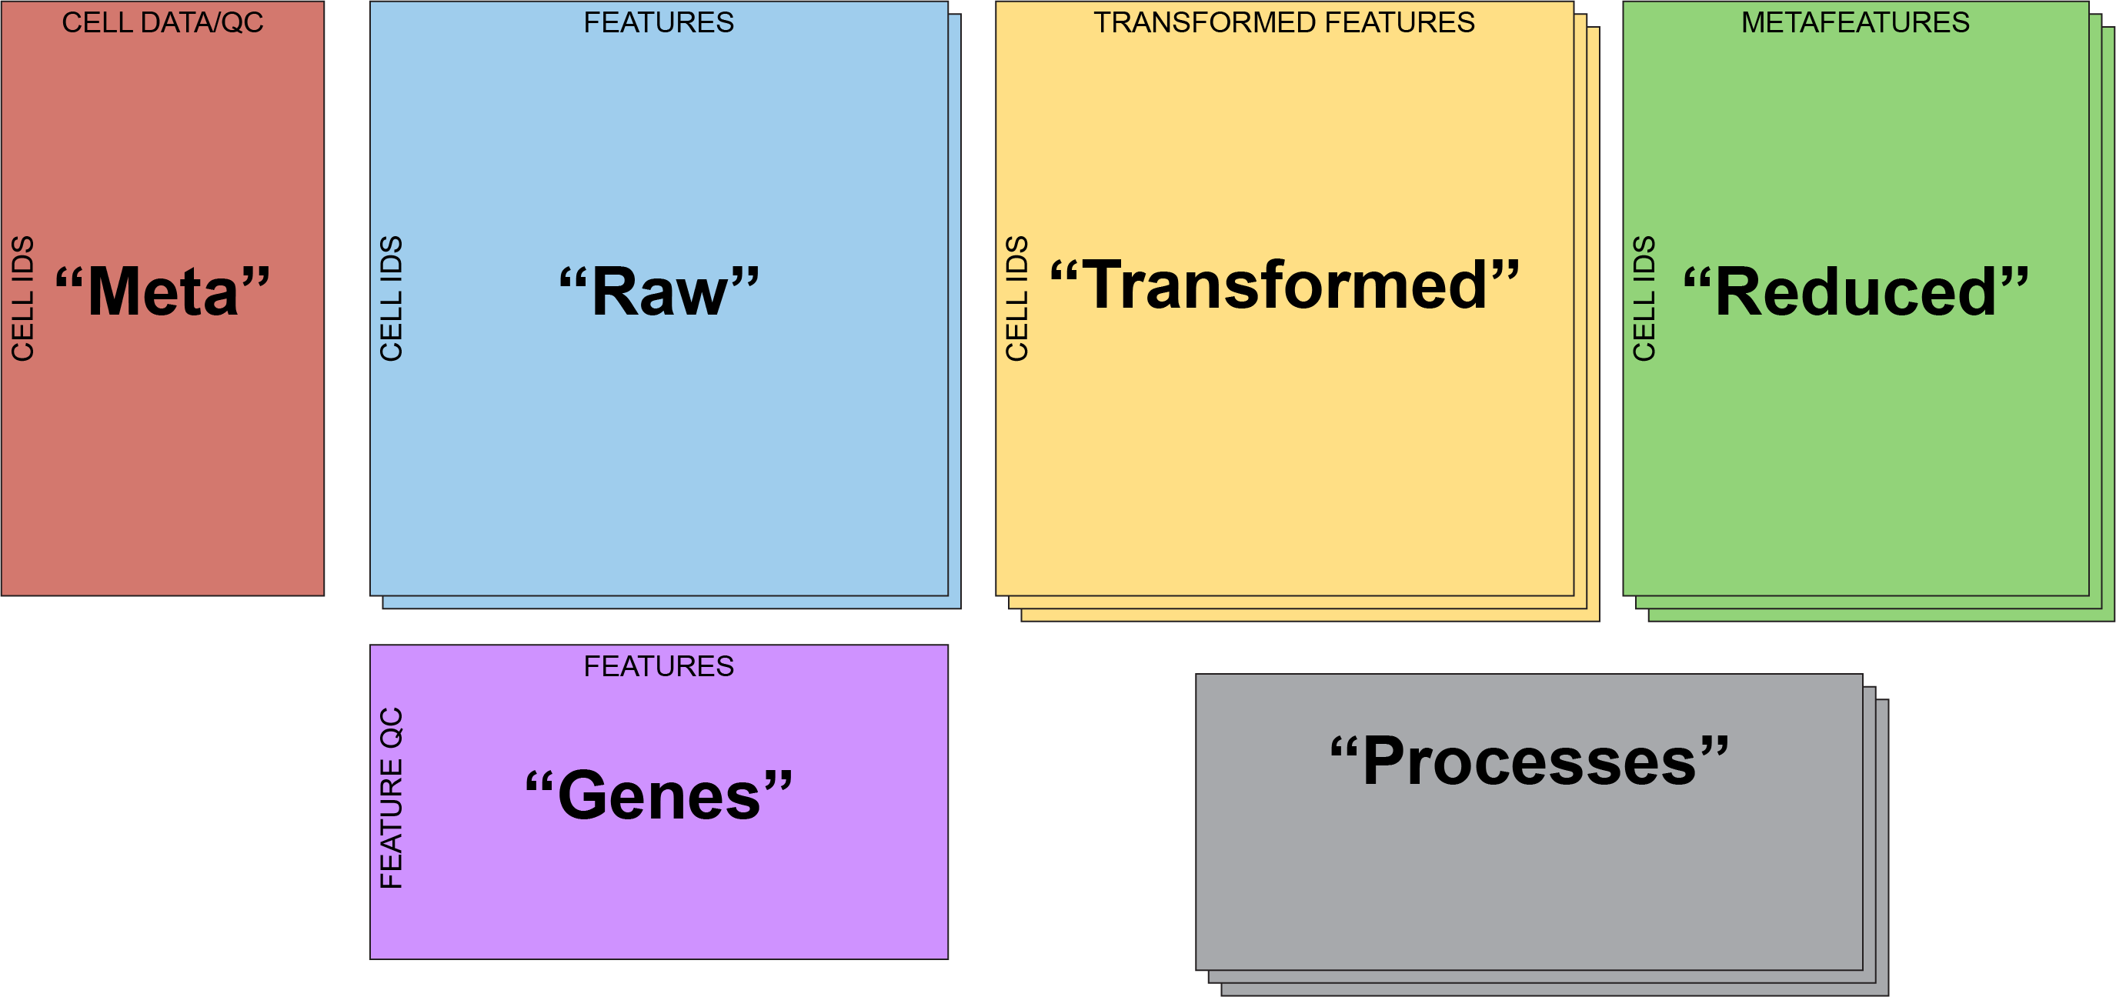
Single Cell Anatomy
“Dimensional Reductions”
“Layers”

Slide 4
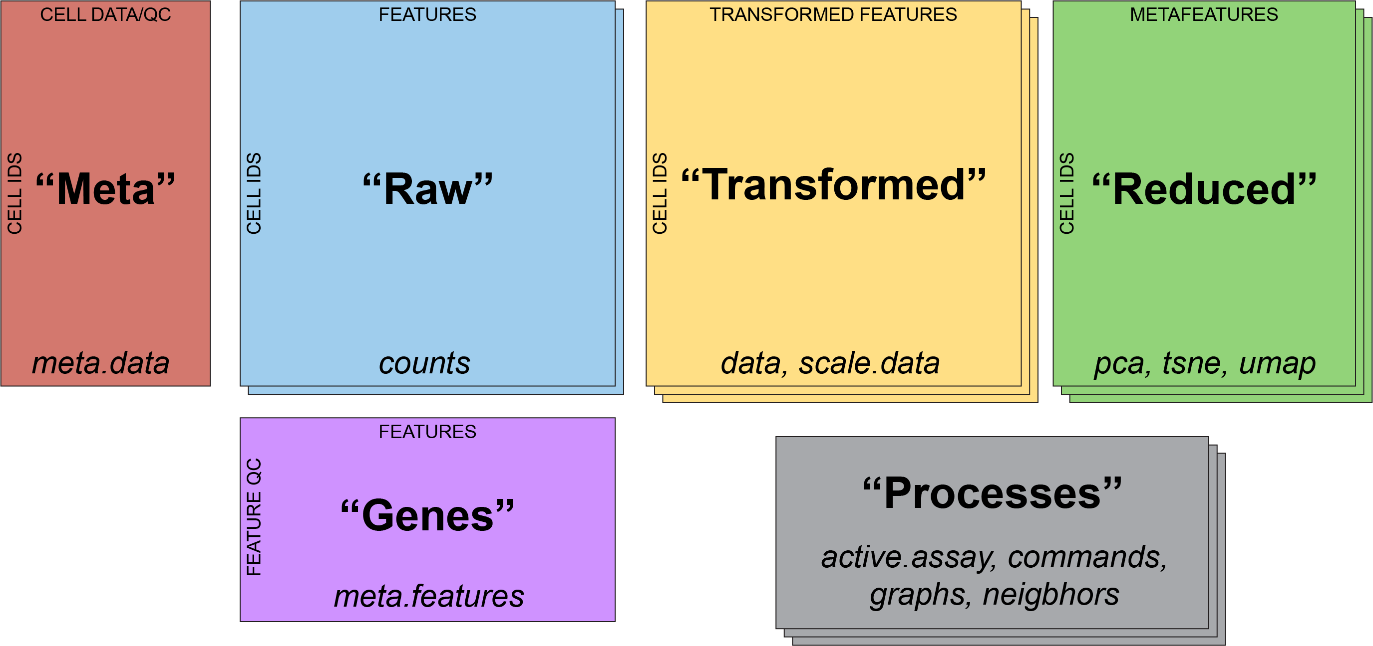
Single Cell Anatomy

Slide 5
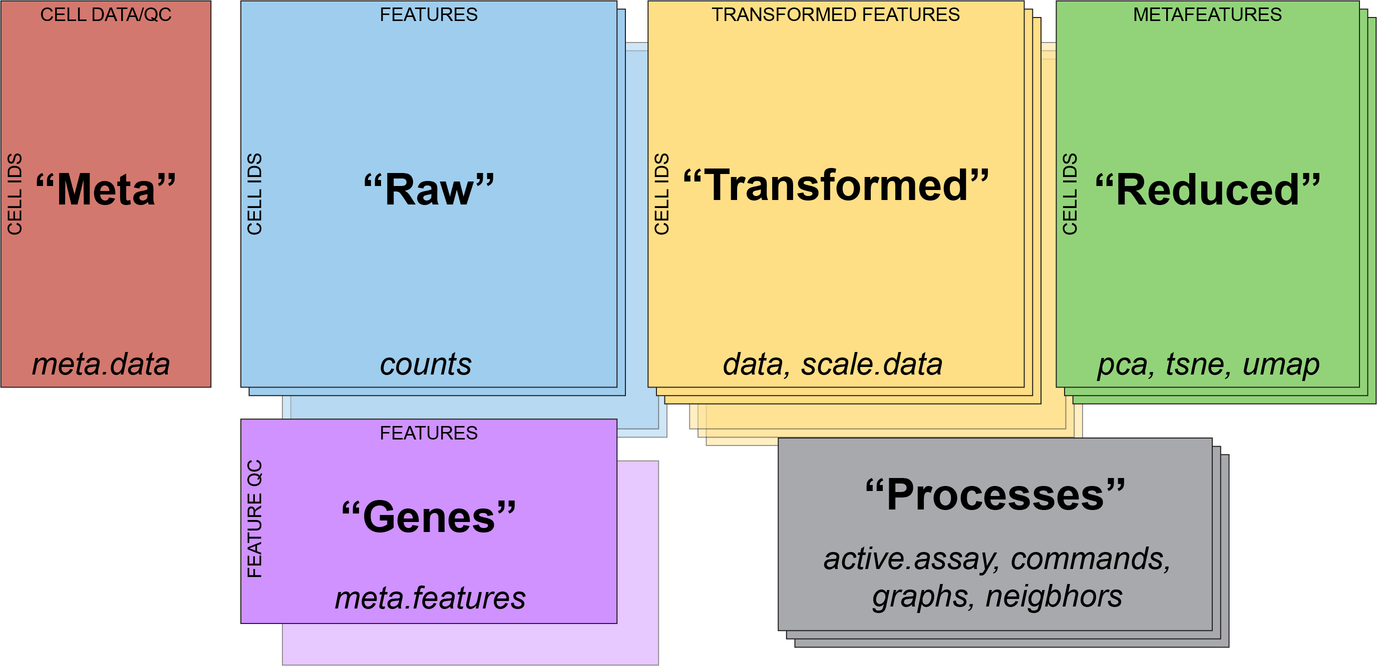
Single Cell Anatomy
“Assays”

Slide 6
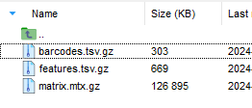
Visual Walkthrough
CreateSeuratObject()

Slide 7
Visual Walkthrough
NormalizeData()
“put all of the cells on the same playing field”
“depth normalization”

Slide 8
Visual Walkthrough
ScaleData()
“put all features on the same playing field”
“emphasize cell-to-cell variation”

Slide 9
Visual Walkthrough
RunPCA()
What will the rownames be in the new “pca” data frame?

Slide 10
Visual Walkthrough
RunUMAP()
How many rows are in the “umap” frame?

Slide 11
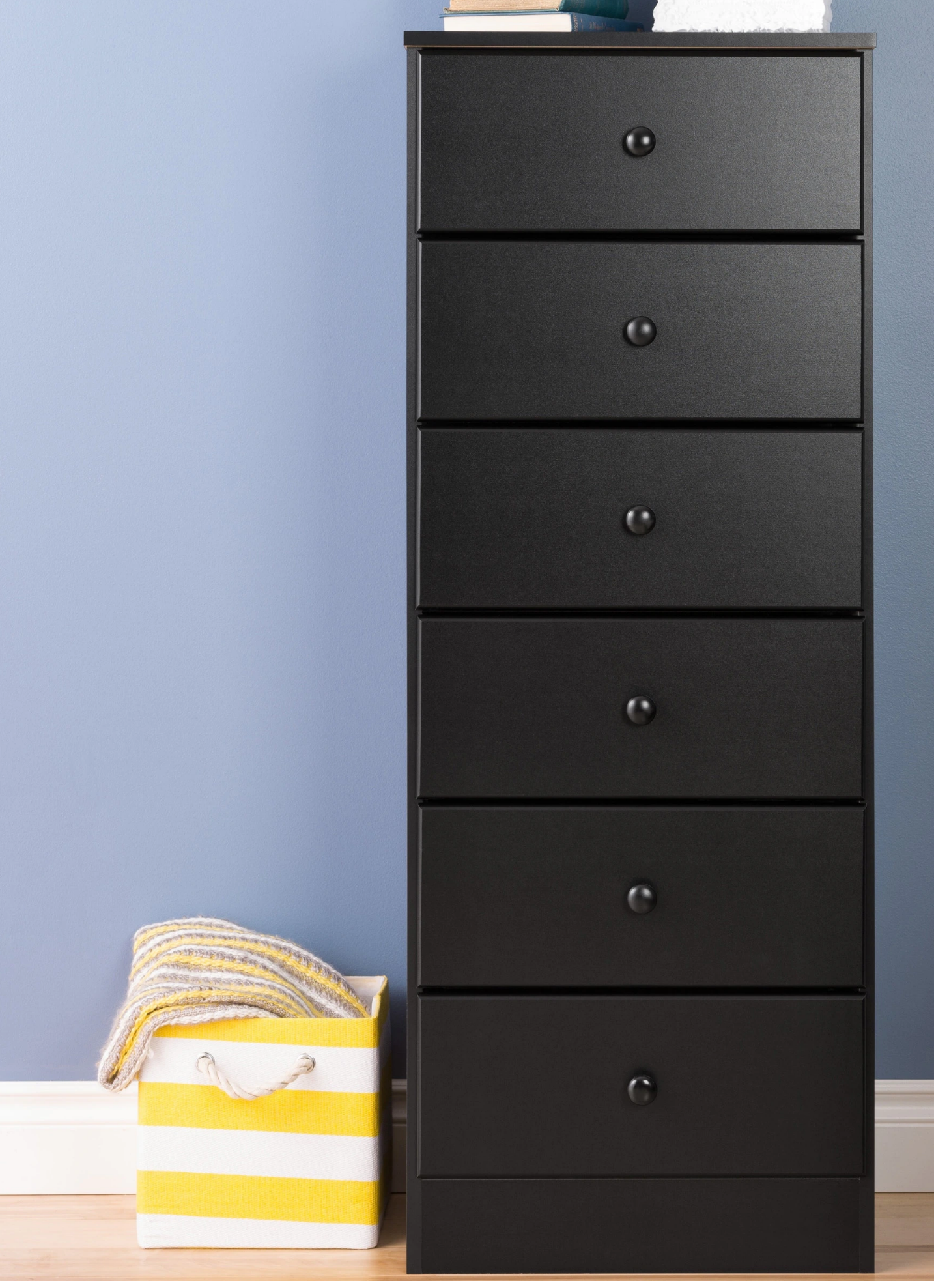
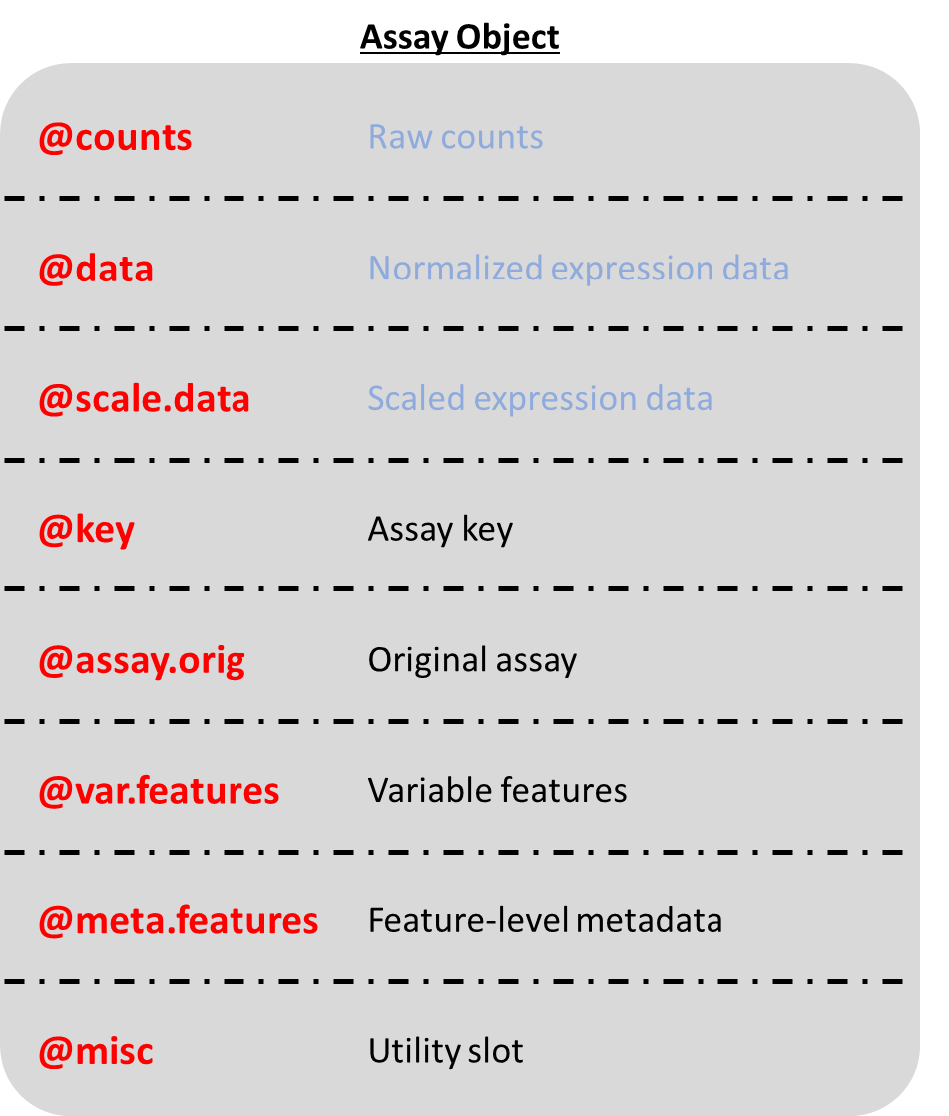
Seurat Object
@assays | List of assays
@meta.data | Dataframe
@active.assay | Active, or default, assay
@active.ident | Active cluster identity
@graphs | List of Graph objects
@neighbors | k.param nearest neighbors
@reductions | List of dim. red. objects
@images | List of spatial image objects
@project.name | Name of the project
@misc | List of miscellaneous information
@version | Seurat Version
@commands | List of commands run on this object
@tools | List of miscellaneous data

Slide 12
Seurat Object
Assay Object
@assays | List of assays
@meta.data | Dataframe
@active.assay | Active, or default, assay
@active.ident | Active cluster identity
@graphs | List of Graph objects
@neighbors | k.param nearest neighbors
@reductions | List of dim. red. objects
@images | List of spatial image objects
@project.name | Name of the project
@misc | List of miscellaneous information
@version | Seurat Version
@commands | List of commands run on this object
@tools | List of miscellaneous data
@counts | Raw counts
@data | Normalized expression data
@scale.data | Scaled expression data
@key | Assay key
@assay.orig | Original assay
@var.features | Variable features
@meta.features | Feature-level metadata
@misc | Utility slot

Slide 13
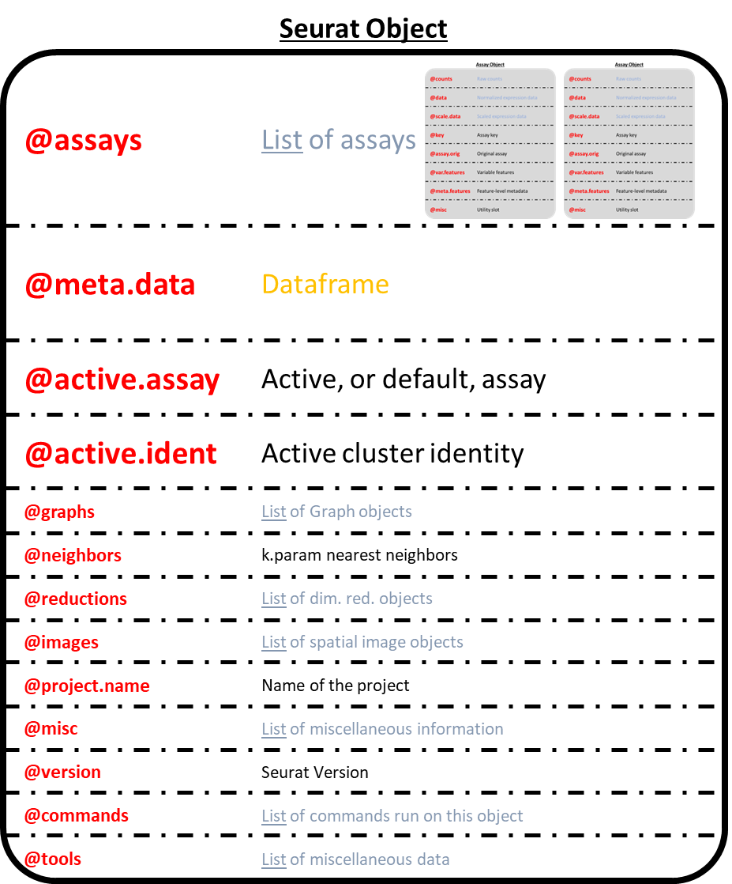
sobj@assays$RNA@counts
“sobj”
“RNA”

Slide 14
Assay Object
@counts | Raw counts
@data | Normalized expression data
@scale.data | Scaled expression data
@key | Assay key
@assay.orig | Original assay
@var.features | Variable features
@meta.features | Feature-level metadata
@misc | Utility slot
Assay <- setClass(
Class = 'Assay',
slots = c(
counts = 'AnyMatrix',
data = 'AnyMatrix',
scale.data = 'matrix',
key = 'character',
assay.orig = 'OptionalCharacter',
var.features = 'vector',
meta.features = 'data.frame',
misc = 'OptionalList'
)
)

Slide 15
Seurat Object
@assays | List of assays
@meta.data | Dataframe: metadata about each cell
@active.assay | Active, or default, assay
@active.ident | Active cluster identity
@graphs | List of Graph objects
@neighbors | k.param nearest neighbors
@reductions | List of dim. red. objects
@images | List of spatial image objects
@project.name | Name of the project
@misc | List of miscellaneous information
@version | Seurat Version
@commands | List of commands run on this object
@tools | List of miscellaneous data
Seurat <- setClass(
Class = 'Seurat',
slots = c(
assays = 'list',
meta.data = 'data.frame',
active.assay = 'character',
active.ident = 'factor',
graphs = 'list',
neighbors = 'list',
reductions = 'list',
images = 'list',
project.name = 'character',
misc = 'list',
version = 'package_version',
commands = 'list',
tools = 'list'
)
)

Slide 16
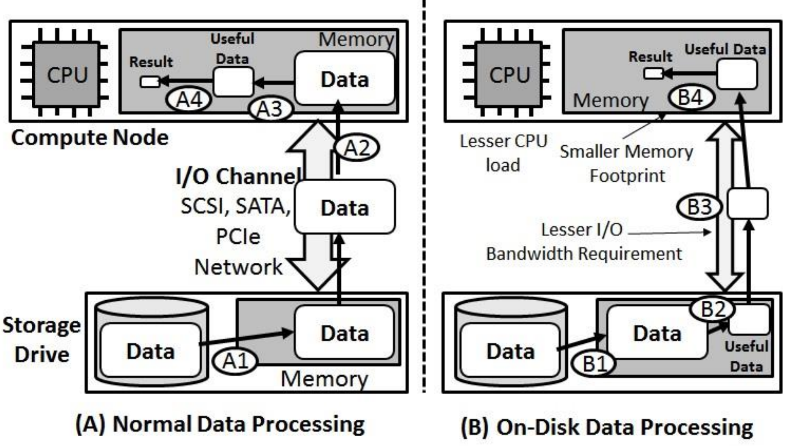
Normal vs On-disk Processing

